Slide 1
First Recorder Lessons
How to get started playing the recorder.
Learn how to
READ and PLAY a steady pulse
READ, PLAY and COMPOSE basic rhythms
READ, PLAY and COMPOSE using the first 5 notes on a recorder

Slide 2
Keeping a steady pulse
How many HEARTS do you see?
We’re going to call them BEATS – like heartBEATS.
The BEAT is the steady, repeating PULSE in music.
When you tap your foot to music at a steady pace, you are tapping the BEAT.
It is the foundation of rhythm and also sets the speed of the music.
Let’s march to the BEAT.
Can you clap and march to the BEAT?
What is the BEAT?

Slide 3
Keeping a steady pulse
1 2 3 4
Try to keep marching but clap only on BEAT 1
How about BEAT 2 ?
BEATS 1 and 3 ?
Choose which BEATS you are going to clap on. Don’t forget to keep marching on every BEAT.
Playing together with a steady PULSE helps us to play at exactly the same time.
It also helps our brains make sense of the music and it’s style.
Why do we need to have a steady PULSE?

Slide 4
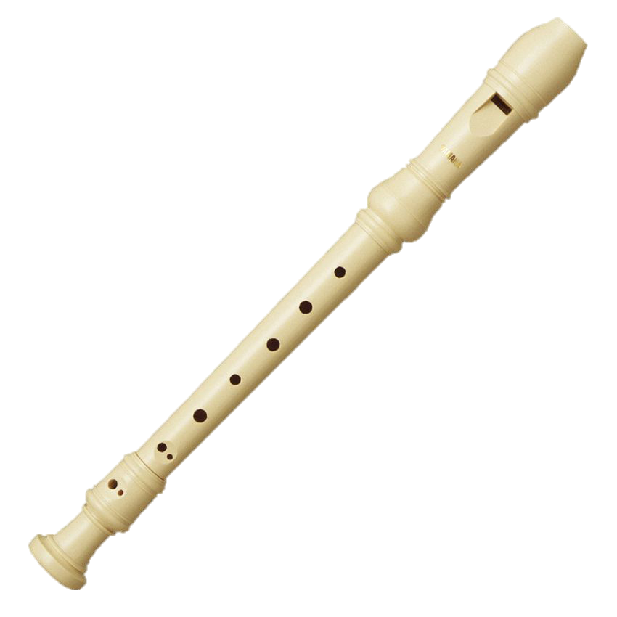
The Recorder
Before we begin playing the recorder, let’s see how it works.
When we blow into the mouthpiece, the air molecules vibrate inside and produce a sound.
When we put our fingers over the holes, we change the length of the recorder and can change the PITCH.
Before blowing into the recorder, see how gently you can blow onto your hand. This is how gently you blow into your recorder. Try it!
Now place your fingers on some of the holes and see what happens.
In music the PITCH is how high or low the note is that you are playing.
Every note sounds different. They all have a different PITCH.
What is PITCH?

Slide 5
B B B B B B B B B B B B B B B
Let’s learn the NOTE B on the recorder
With your left hand at the top,
place your thumb on the hole at the back and your first finger on the hole at the top. Squeeze tightly!
Blow very gently.
How does that sound ?
thumb

Slide 6
AAAAAAAAAAAAAA
How about the NOTE A
Still with your left hand at the top and your thumb on the hole at the back, add your second finger to the next hole. You should now have 2 holes covered and only be using 1 hand. Squeeze tightly!
Blow very gently.
How do A and B sound different?
thumb
B sounds a little bit higher than A

Slide 7
Let’s play the note B on every star.
Are you still feeling the beat?
Try again with the note A
How many notes did you play on each beat this time?

Slide 8
This time the note lasts for 2 beats.
These are longer notes.

Slide 9
Time to mix it up.
Can you make up some patterns of your own?

Slide 10
Draw your rhythm patterns in the hearts below.
1 2 3 4 1 2 3 4
Printable sheet

Slide 11
GGGGGGGGGGGGGGG
You really need to try hard for G. If you just drop your finger on, it won’t cover the hole. Look at the position of the holes, they are not in a straight line, you need to deliberately bend your finger round a bit.
The lower your note is, the more gently you need to blow to achieve a good sound.
It’s worth getting G right, as all lower notes depend on it.
Let’s move on to the NOTE G
Put your fingers on for B. Then A, now add your next finger for G.
3 holes at the front should be covered.
Still only use 1 hand and still squeeze tightly!
Blow very gently.
thumb
Tips for playing G

Slide 12
BAG BAG BAG BAG
Which note sounds highest?
B A G
th
th
th
Try playing all 3 notes.
Can you mix up the order and make up your own tune?
Which note sounds lowest?

Slide 13
Using the notes BAG, colour in the holes for the correct note to compose your own piece of music.
Printable sheet

Slide 14
Hot Cross Buns
Count 1-2-3-4 to start
Clap the rhythm
Sing the tune
Play the tune
B A G
B A G
B B B B
A A A A
How do I start?
B A G

Slide 15
Merrily We Roll Along
B A G A
B B B
A A A
B B B
B A G A
B B B
A A B A
G

Slide 16
Music Notes
Music notes are different shapes depending on how long or short they are. Here are some commonly used notes and how long they last.
Quavers Crotchet Minim Dotted Minim Semibreve
½ ½ beat 1 beat 2 beats 3 beats 4 beats
Can you create some musical maths?
Which note is the shortest?
Which note is the longest?
Do you know their proper names?

Slide 17
Practice drawing your own music notes here. See if you can make up some musical maths.
+
=
-
=
½ ½ + 1 = 2 3 - 1 = 2
Printable sheet

Slide 18
Rhythm
A RHYTHM is when we play long and short notes in a pattern. RHYTHM is different to PULSE. A RHYTHM changes throughout the music whereas the PULSE remains the same.
ta ta taa
ta - ti ta ta - ti ta
Can you clap these rhythms? Count 1-2-3-4 before you start.
Saying ta and ta-ti makes it easier to keep the pulse the same.
Try making up some of your own rhythms.

Slide 19
Make up your own rhythms using these notes. You can use them more than once.
Printable sheet

Slide 20
Hot Cross Buns
B
A
G
B
A
G
B
B
B
B
A
A
A
A
B
A
G

Slide 21
Merrily We Roll Along
B
A
G
A
B
B
B
A
A
A
B
B
B
B
A
G
A
B
B
B
A
A
B
A
G

Slide 22
The Music Stave
We know how to play BAG on the recorder and we can play tunes reading the rhythm. Now we are going to learn how to recognise WHICH note to play by reading the music off a chart. We call this chart a music STAVE or STAFF. By learning where each note lives on the STAVE, we will know what PITCH to play.
High notes sit at the top of the music stave.
HIGH NOTES
LOW NOTES
Low notes sit at the bottom of the music stave.
Each note either has a LINE through the middle
OR is sitting in a SPACE in between the lines.

Slide 23
Draw your own music notes on the music staves. Remember, notes either have a line straight through the middle, or they sit in the space between two lines.
Printable sheet

Slide 24
B B B B B B B B B B B B B B B
thumb
LINE 3

Slide 25
AAAAAAAAAAAAAAA
thumb
SPACE 2
B is one step higher than A as it is written one step higher on the ladder.
Which note is higher, A or B?

Slide 26
GGGGGGGGGGGGGGG
thumb
LINE 2
G is lowest as it is written on a lower line of the ladder.
Which note is the lowest note, B, A or G?

Slide 27
BAG BAG BAG BAG BAG
LINE 3
SPACE 2
LINE 2
B A G
Do you remember which note is which?

Slide 28
Write your own piece of music using the notes BAG.
Printable sheet

Slide 29
This number tells us how many beats are in each bar.
In Hot Cross Buns, every bar adds up to 4
Hot Cross Buns
What does this number tell us?
B A G B A G B B B B
A A A A B A G
Can you remember the note names?

Slide 30
Merrily We Roll Along
B A G A B B B A A A B B B
B A G A B B B A A B A G
Don’t forget to clap and sing before you play
Try naming the notes

Slide 31
Au Clair de la Lune
G G G A B A G B A A G
G G G A B A G B A A G
What do you notice about lines 1 and 2?
Try naming the notes

Slide 32
Compose your own tune using GABC. Can you write it on the music stave?
Printable sheet

Slide 33
CCCCCCCCCCCCCCCC
thumb
SPACE 3

Slide 34
Clown Dance
G A B B C C C B A B G A A
G A B B C C C B G A A G G
Are these two lines the same or different?
Can you spot the new note C?

Slide 35
DDDDDDDDDDDDDDD
LINE 4

Slide 36
Compose and write your own tune using GABCD. Try some tricky rhythms.
Printable sheet

Slide 37
Jingle Bells
B B B B B B B D G A B
C C C C C B B B B B A A B A D
B B B B B B B D G A B
C C C C C B B B B D D C A G

Slide 38
When The Saints Go Marching In
What does this sign mean?
sh G B C D sh G B C D
This sign is called a REST.
It means take 1 beat of no playing or long enough to say sh.
sh G B C D B G B A
sh B B A G G B D D C
sh sh B C D B G A G

Slide 39
I hope you have found these first steps useful. They are very basic and I could have added lots more detail. We haven’t touched on loud and quiet playing, smooth or detached playing and many more ways to play each piece. Check out the audio file if you want to know some more.
If you want to advance your recorder players further, take a look at:
Razzamajazz – Sarah Watts
Red Hot Recorder – Sarah Watts
Recorder from the Beginning – John Pitt
Enjoy, Carol

